Slide 1
Lecture 17 – Sorting
Selection Sort
Kok-Seng Wong | 2021

Slide 2
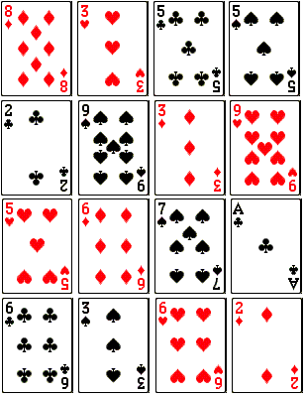
Motivation example
How to sort these cards?

Slide 3
Learning outcomes
Upon the completion of this lecture, students will be able to:
explain the basic sorting algorithms, i.e., selection sort.
write sorting algorithm in different data structures.

Slide 4
sorting
Numeric List
Alphabet List
Ascending Order:
1 | 2 | 3 | 4 | 5
5 | 1 | 2 | 4 | 3
Descending Order:
5 | 4 | 3 | 2 | 1
Ascending Order:
a | b | c | d | e
d | e | a | c | b
Descending Order:
e | d | c | b | a

Slide 5
Built-in sorting methods (review)
sorted(): for any data structure
list.sort(): only for lists
>>> a = [4, 6, 5, 2, 3, 7, 1, 4]
>>> sorted(a)
[1, 2, 3, 4, 4, 5, 6, 7]
>>> a
[4, 6, 5, 2, 3, 7, 1, 4]
>>> a = [4, 6, 5, 2, 3, 7, 1, 4]
>>> a.sort()
>>> a
[1, 2, 3, 4, 4, 5, 6, 7]
It modifies the original list

Slide 6
Sorting algorithms
Selection Sort
Inserting Sort
Bubble Sort
Merge Sort
Heap Sort
Quick Sort
Top 5 sorting algorithms

Slide 7


Slide 8
Selection sort idea
Divide an array into: sorted and unsorted sub-list.
Repeatedly finding the smallest element (for ascending order) in unsorted sub-list and insert it to the sorted sub-list.
Sorted sub-list | Unsorted sub-list | Smallest element in unsorted sub-list
() | (95, 15, 8, 72) | 8
(8) | (95, 15, 72) | 15
(8, 15) | (95, 72) | 72
(8, 15, 72) | (95) | 95
(8, 15, 72, 95) | ()

Slide 9
Class practice
Use a table (as shown in Slide 8) to illustrate the sorting of the following lists in ascending and descending orders:
a = [4, 6, 5, 2, 3, 7, 1, 4]
a = [74, 26, 55, 21, 13, 7, 101, 8]

Slide 10
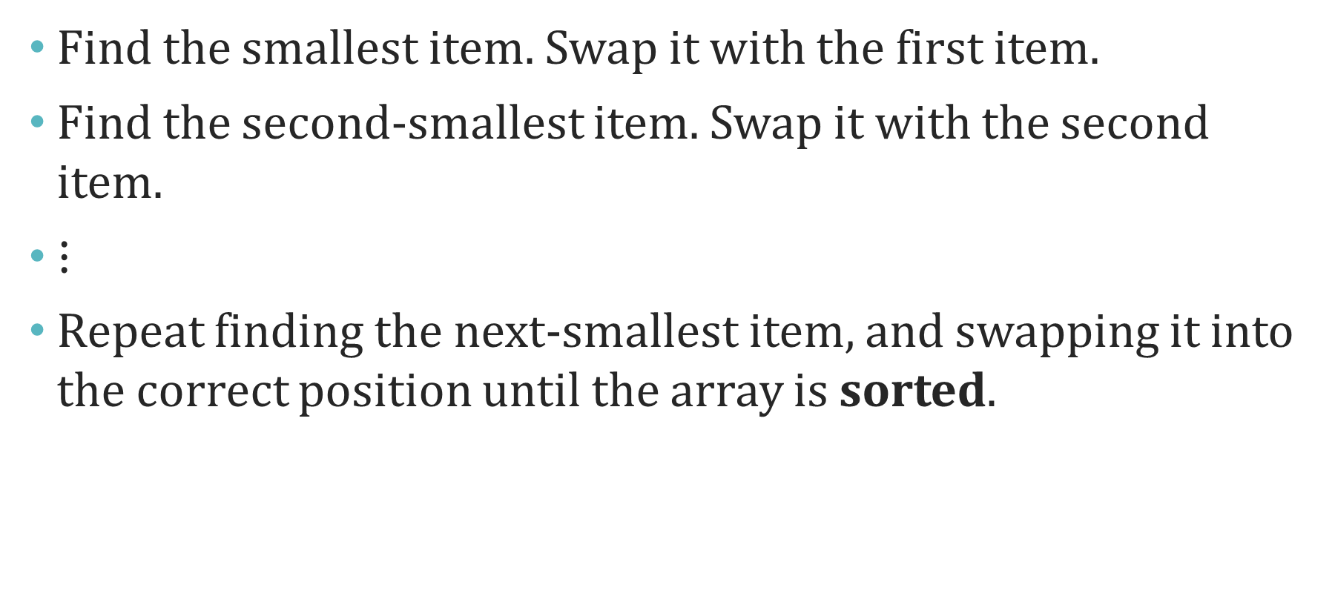
Selection sort pseudocode
Find the smallest item. Swap it with the first item.
Find the second-smallest item. Swap it with the second item.
$⋮$
Repeat finding the next-smallest item, and swapping it into the correct position until the array is sorted.

Slide 11
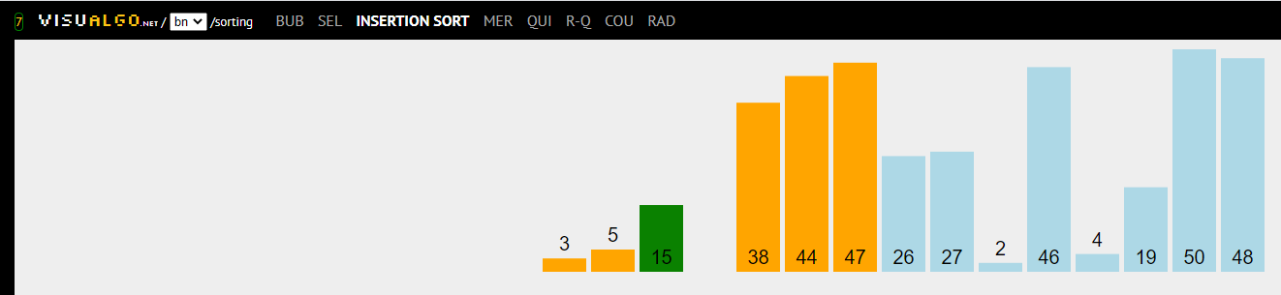
visualization

Slide 12
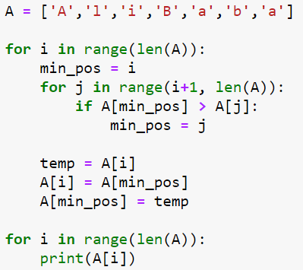
Selection sort
swapping

Slide 13
Group discussion

Slide 14
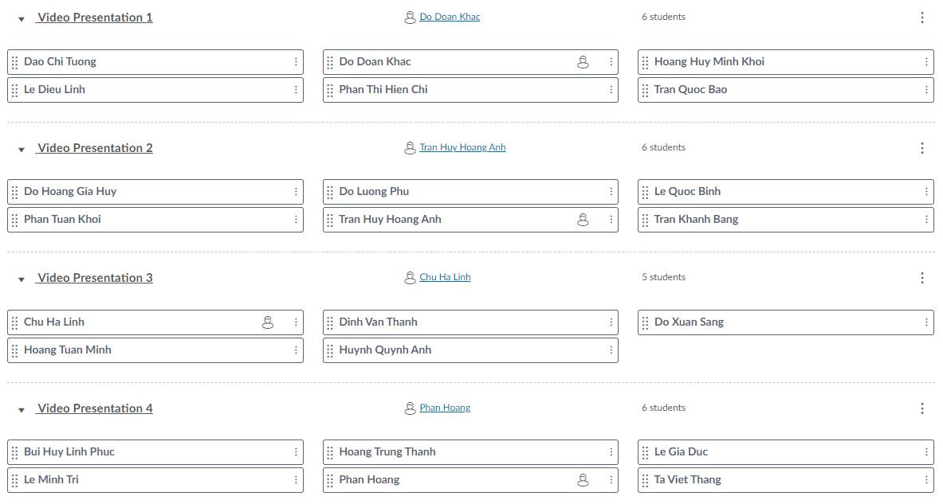

Slide 15
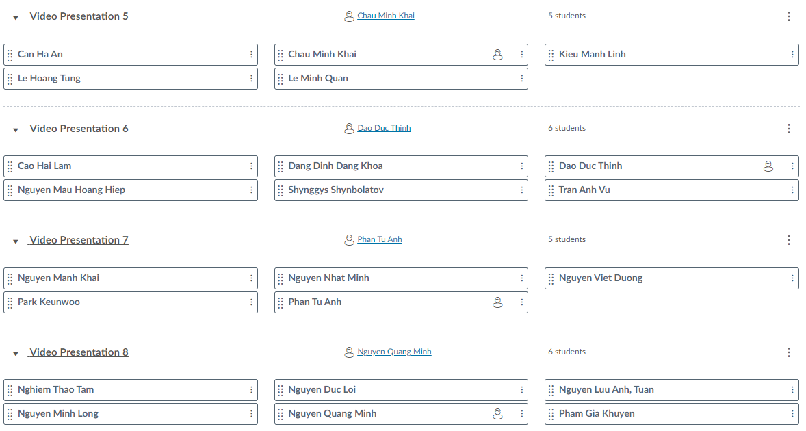

Slide 16
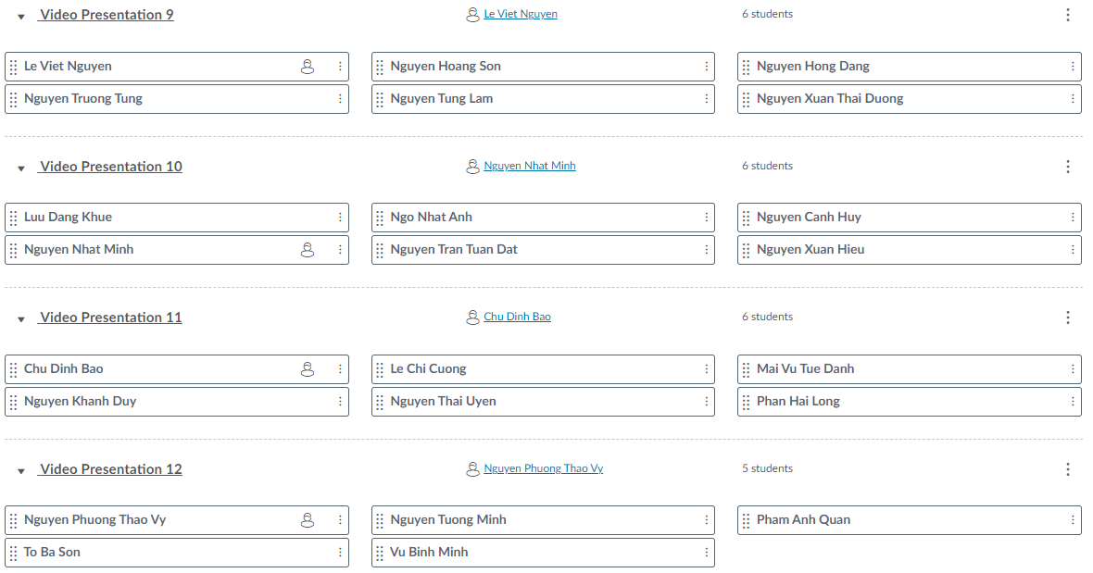

Slide 17
group practice 1
Write a selection sort program in Python that only sort the lowercase letters in a list. [Group 1-4]
Write a selection sort program in Python that accept tuple as input. Your program should be able to sort the items in a tuple entered by the user. [Group 5-8]
Modify the selection sort program in slide 12 so that it sorts in descending order. [Group 9-12]

Slide 18
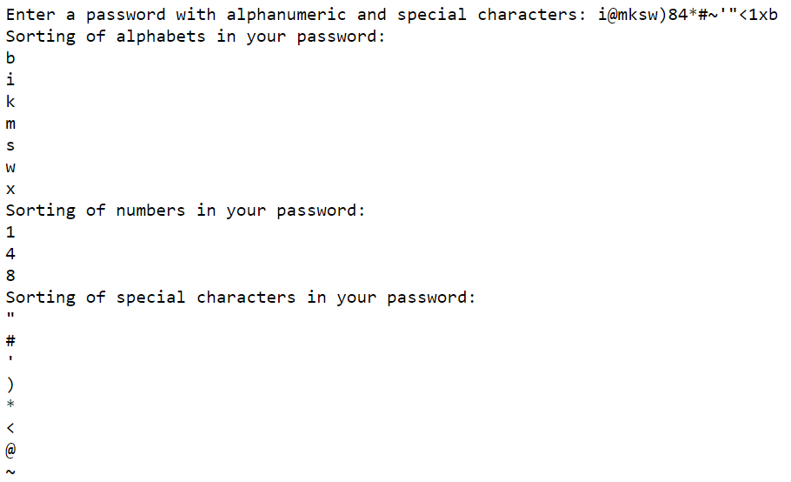
What will be the problem set of this output?

